Slide 1



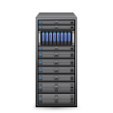

The Value of EMC
Information Intelligence Group
RSA Security
INFORMATION
INFRASTRUCTURE
PRODUCTS
INFORMATION
INFRASTRUCTURE
PRODUCTS
Greenplum Data Computing
Backup & Recovery Solutions
Storage
Notes:
Two key businesses:
EMC
VMWare
“EMC Corporation is a global leader in enabling businesses and service providers to transform their operations and deliver IT as a service”

Slide 2

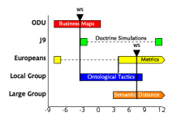

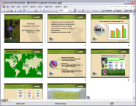







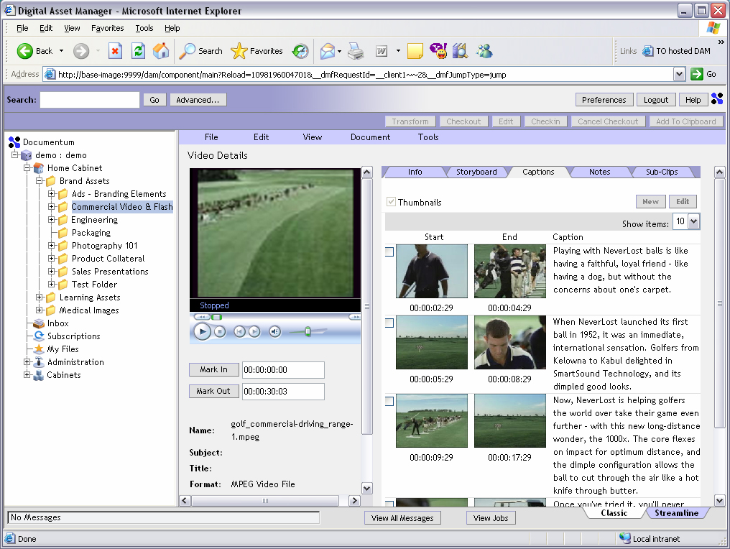



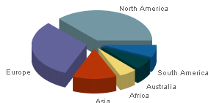

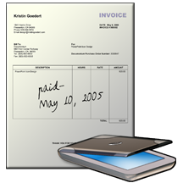
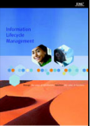

Enterprise Perspective
Policy
Guidelines
Mobile Productivity
Global Access
Knowledge Retention
Etc.
Customer
Correspondence
Risk Analysis Simulations
E-mails
Value Realization
Project
Documents
Content Automation
Governance
Collaboration
Information Rights Management
Search and Findability
Policy Management
Etc.
Value Added Services
Complete
Secure
Accessible
Training Materials
Decision Support Materials
Marketing Communications
Payment Images
Customer Account Setup Documents
Case Files

Slide 3
The Documentum Product Set
xCP
Compose
Clients: D2, xCP, Mobile, Solutions
Document
Sciences
Multi-channel
publishing
Design
Enterprise Services Framework
Security Services
Audit, Access Control
Process
Services
Archive
Services
Compose
Unified Analytics Platform
Big Data
Deploy
Content
Services
Compliance
Services
Captiva
Capture
Services
Manage
Repository Services: Metadata Model
D2
Configure
Kazeon
E-Discovery
Services
Content Server Repository
Content
xml
metadata
Full text
External
Stores

